Slide 1
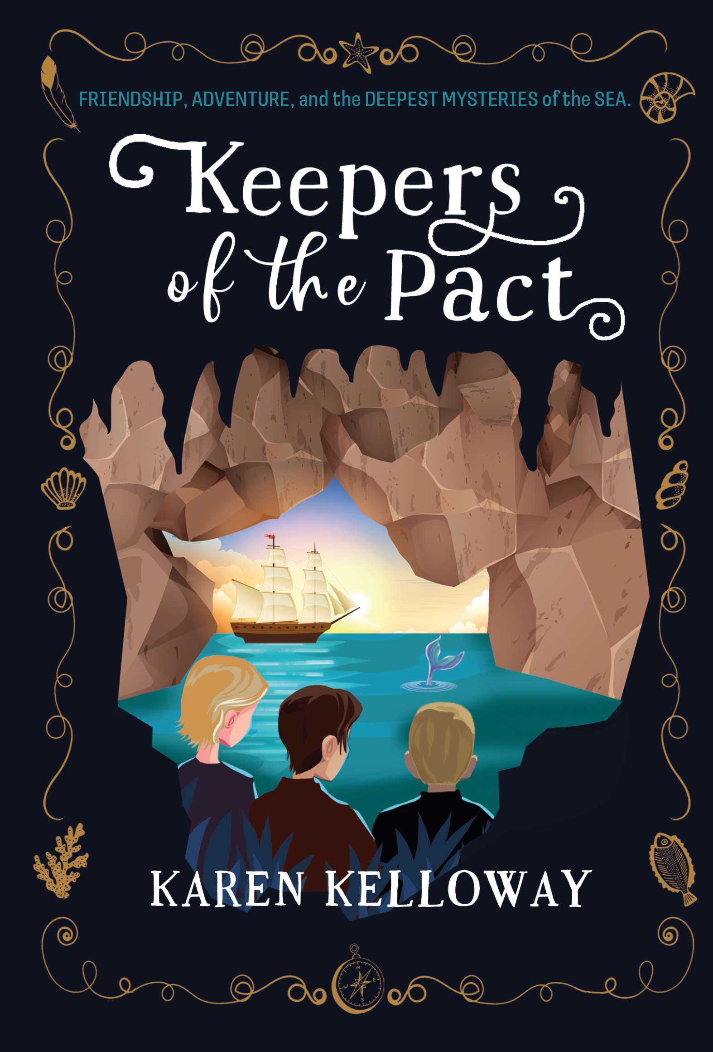

Classroom
Learning
Author Karen Kelloway

Slide 2




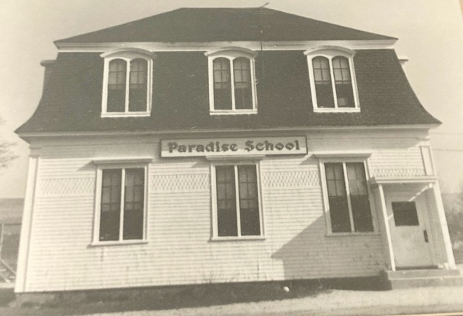
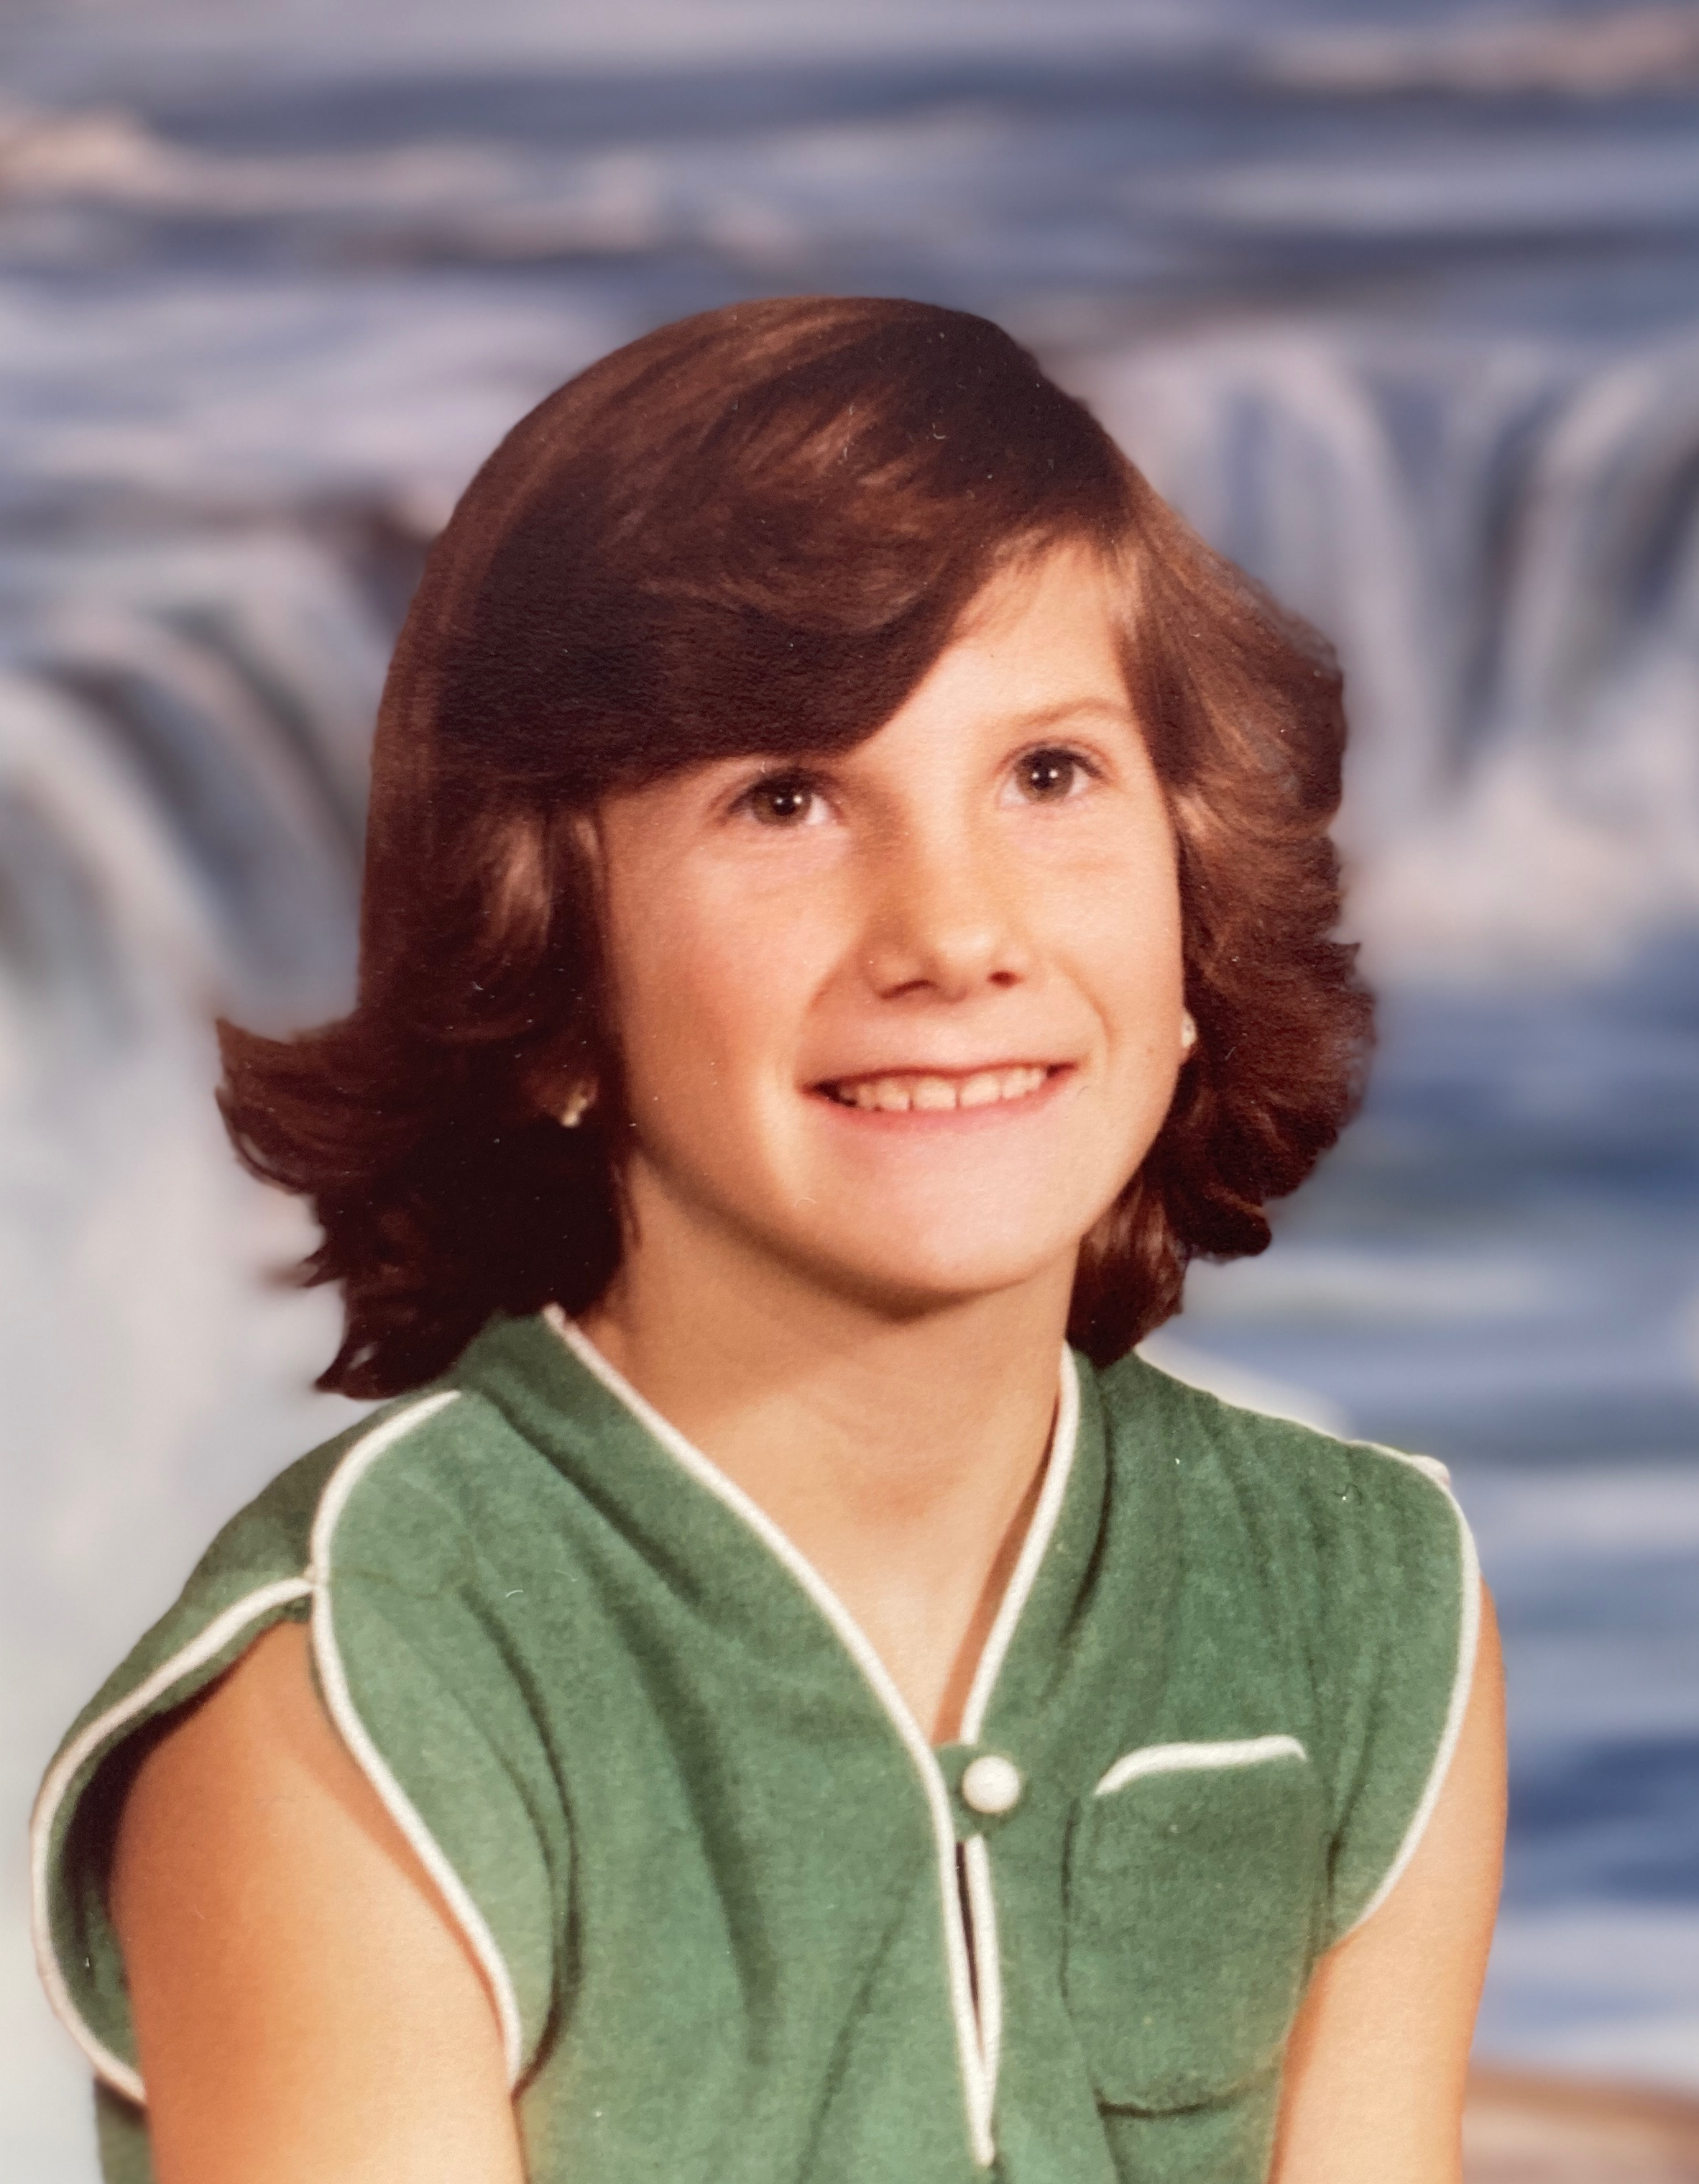

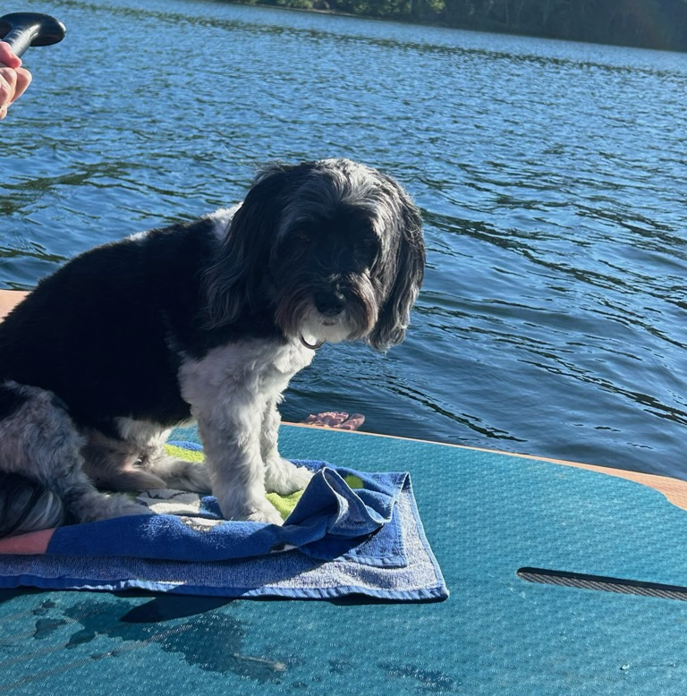

About Karen Kelloway
My elementary school
My favourite book
Me in Grade 5!
My dog Chewie

Slide 3
What’s Your Idea?

Slide 4

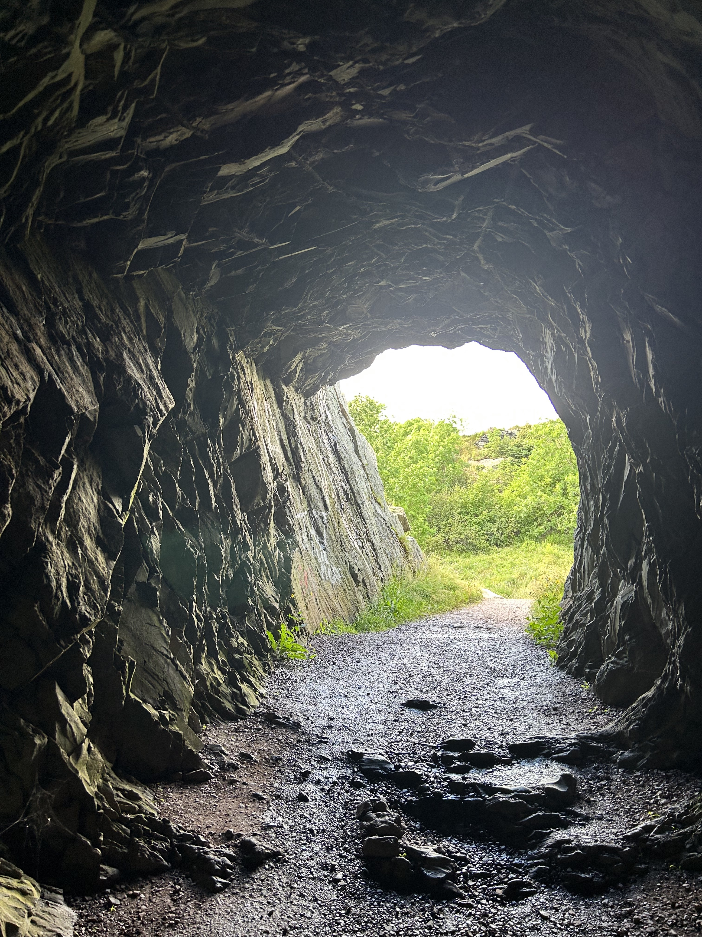
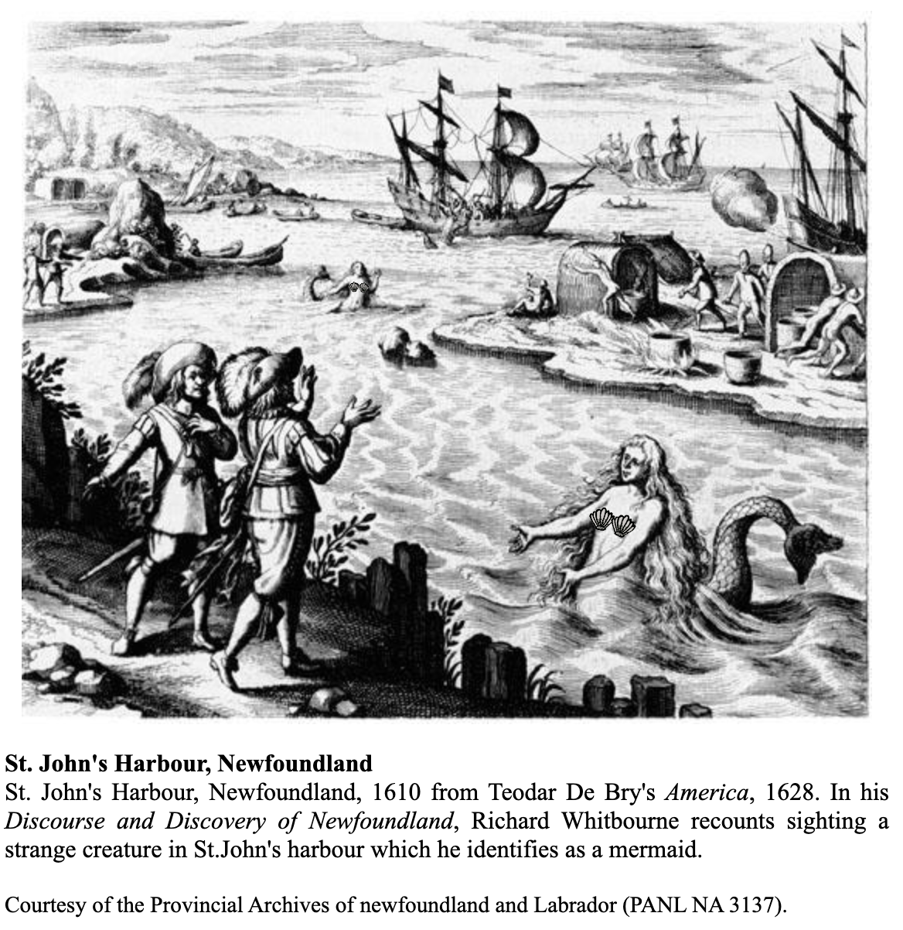
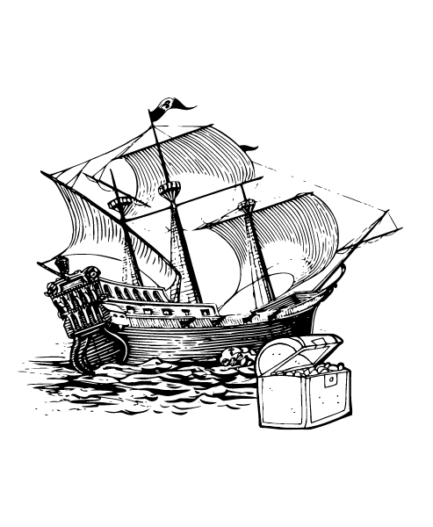
Three Anchors for my Story
Notes:
While Keepers of the Pact blends fact with fiction and adds in a supernatural twist, there are three anchors that influenced my story:
First, the Brigus tunnel, a 30-meter pathway blasted through solid rock in 1860 so that vessels could more easily unload their cargo.
Second, a reported mermaid sighting in the St. John’s harbour (1610).
Third, the fabled stories of Peter Easton’s pirating activities along the Newfoundland & Labrador coast (1612).

Slide 5
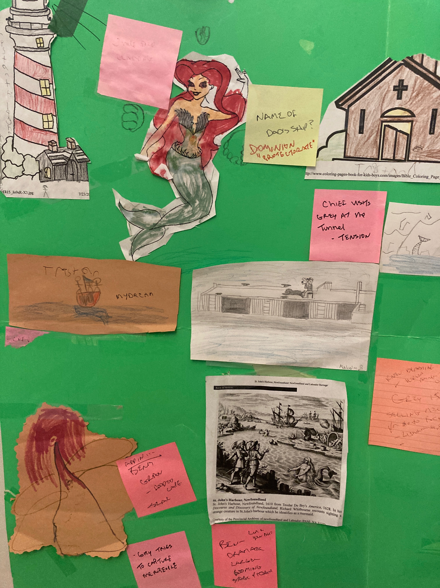
Start with a Story Board
Notes:
This is how I started my story! First, I came up with the idea then I started to map it out. My daughter was only young then so she colored the mermaid and lighthouse. My nephew, Malcolm, sketched the wharf with Old Man Jake and Brig as well as the the mermaid’s tale while my son sketched the mystery ship. I often will add sticky notes to ask myself questions and then take them down and put new ones up. It’s a place to put my ideas until I’ve integrated them into the story.

Slide 6
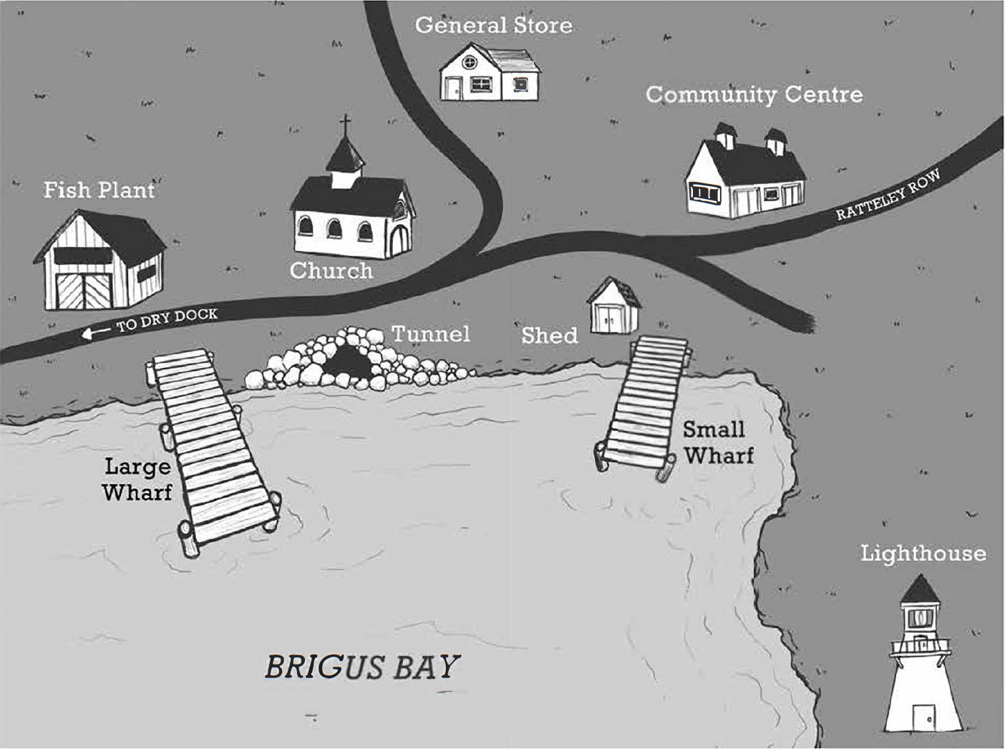
The Final Map
Notes:
And even though the book has some historical facts and the setting of the story is in a real place (the town of Brigus in Newfoundland & Labrador) I still made up some of the details. You can do that when you’re writing fiction. Here you’ll see a map the graphic designer created for the front of the book.

Slide 7
3 Rs:
Research – Rework – Rewrite

Slide 8

Research!
Find facts that help make your story believable.
Example…
  Ship Terms (I interviewed an expert, author John Boileau)
  My Question: How do I get Alistair, Ben and Sadie on board the mystery ship?
  His Answer: Cargo nets!
  Read how I used his advice at the bottom of p. 86, into p. 87
Notes:
When we’re writing fiction, the reader still has to believe what they’re reading. There will always be areas in the story that you can fact check. For me, I had a lot of ship and nautical terms. I don’t know how how to sail so I had to find someone who could help. There is only so much you can do with an internet search. I like to find real people to interview. I interviewed John Boileau, a Nova Scotian author who knows a lot about ships. I shared parts of my story where I was having issues and he helped me problem-solve.
On the bottom of page 86 into page 87, for example, you’ll read the part where the kids first climb on board the mystery ship. I first had them climbing a ladder. But John suggested that a cargo net would be a better way. I didn’t even know what a cargo net was! As you read that passage you’ll see how I worked that in.

Slide 9

Rework!
Check your Character’s Believability
From:
Alistair Wearing Glasses ( in original manuscript)
From:
“He bent down to scoop handfuls of blueberries that overflowed from the low bushes on either side of the trail, popping them into his mouth.”
From:s
To:
Alistair not wearing glasses (in final edit) was more believable…but the glasses were part of an important scene so we had to find a replacement – we used his father’s compass.
Notes:
Sometimes in the final edit we make what are called ‘global changes’ to help ensure the characters are believable and that the story flows.
In the first example, I originally had Alistair wearing glasses. The original manuscript had him taking them off in the boat, losing them in the cave, etc. The editor’s comment was that it felt ‘clunky’. As in, could he actually see the mystery ship from afar if he didn’t have his glasses on. And wouldn’t they get misted up on the ocean, etc. BUT if we took out the glasses we would miss the important scene on page 127. Initially Alistair's mom notices his glasses were on the seat of the skiff. We came up with the idea of the compass, which we introduce on page one and then from there had to continue that thread. That is an example of a global change.

Slide 10

Rewrite!
Make your Story Sing
From:
“He bent down to scoop handfuls of blueberries that overflowed from the low bushes on either side of the trail, popping them into his mouth.”
To:
“Alistair pulled a handful of berries off a bush and scooped them into his mouth. The subtle sweetness hit his tongue, a welcome change from the syrupy flavour of Ben’s candy corn.”
p. 53
From:
“Merpeople,” said Ben, his face agog. “It’s one of those merpeople.”
To:
“Merpeople,” said Ben, his face flushed. “It’s one of those merpeople.”
p. 98
Notes:
These changes are part of the final editing process. Notice the difference in the sentences. In the first example, we’ve added in more active verbs and added in a description of what the berries taste like.
In the second example, when I re-read that line, I pictured Ben as more ‘flushed’ then ‘agog’. Editing takes a lot of thought! You want to really think about the best word to create the picture in your reader’s mind.

Slide 11
Something Fun
Using Examples from Real Life
“Now what do I do?” said Ben over the screech of the fiddle...The slice of pie he was serving had slipped off his plate—cream and all—and landed on the back of Mrs. Spinney. Blueberry juice was seeping down her dress. Only she didn’t seem to notice and just kept on eating her meal, chatting to her tablemates and tapping her toes to the sound of the fiddle.
p. 158
Notes:
This scene was inspired by my best friend, Sherri. When we were kids we grew up in a small town called Paradise, Nova Scotia. There was a community hall, just like the one in the story. And one evening we had to serve food at a potluck. Sherri was serving Lemon Meringue pie – which yellow in colour, lemon flavored and looks like thick jello with meringue whip on top.
As Sherri was serving it, it slipped off the plate on down the back of a woman’s dress. The woman didn’t notice. We had a Mrs. Spinney who lived in the community at the time so I named this character after her.

Slide 12
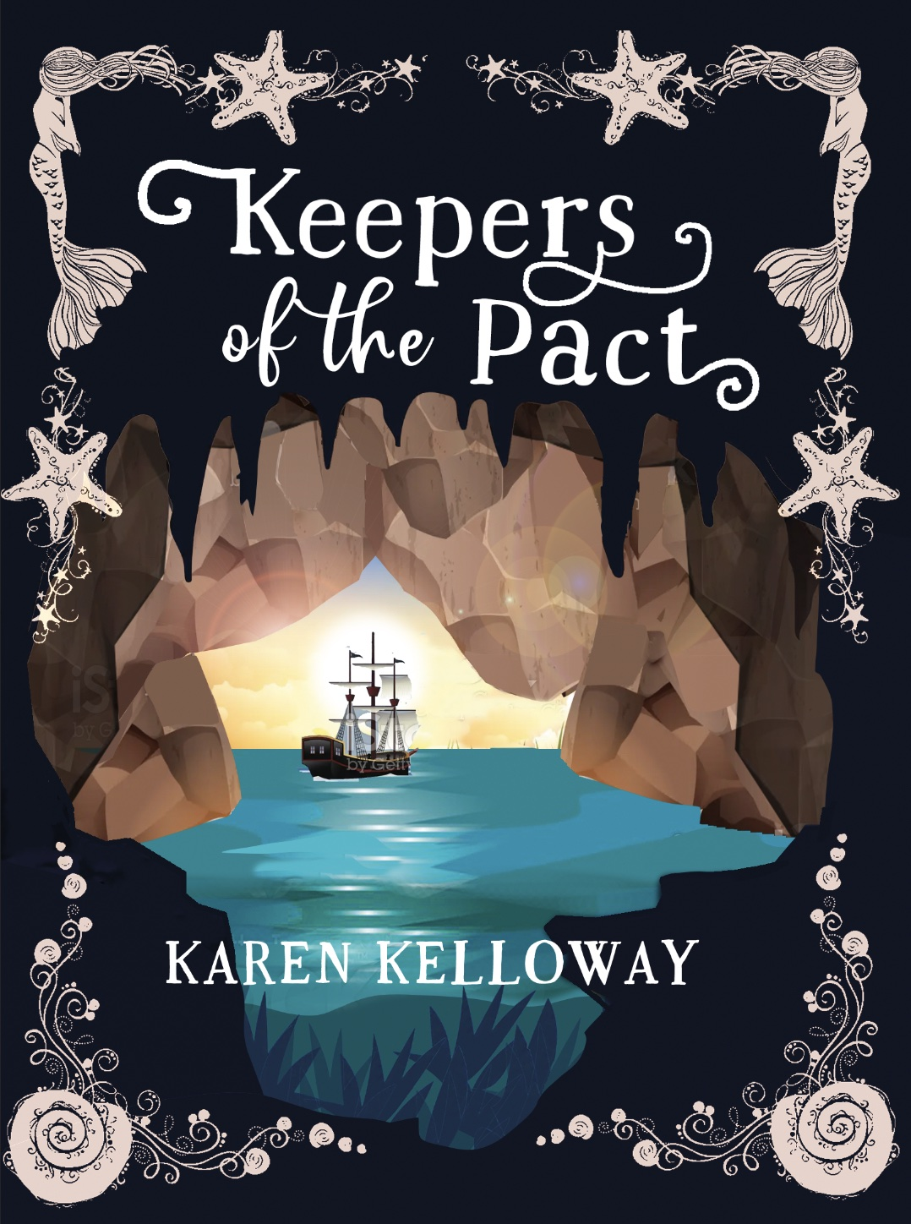
Final Touches
Notes:
Notice the first version the graphic designer created from the final. What changed?

Slide 13

Writing Exercise
10 – 15 minutes
Imagine.. you are playing in the ocean and you meet a merperson.
  Describe the scene:
  What are you thinking? How do you react?
  What details do you notice about the merperson?
  Do they talk? If so, how do they sound?
You can write a paragraph (fiction) or answer the questions as facts.
Notes:
I found it challenging to come up with original ways to describe a merperson because I hadn’t actually met one (yet). Here’s a writing exercise for you to come up with your own description.

Slide 14
BONUS ACTIVITY
MAKING THE MOST OF METAPHORS!
On page 17, the author writes:
“Alistair tried to be brave, but he felt a bit like Ben sounded—like his insides were made of Jell-O.”
The author is using Jell-O as a METAPHOR to create a vivid picture in our minds of how Alistair feels. What do you think it mean that his insides were made of Jell-O?
INSTRUCTIONS: Picture yourself in the cave. Think of another metaphor to describe how your stomach would feel if you were scared. Write that down and then share your ideas!

Slide 15
BONUS ACTIVITY
GRANDMOTHERS ARE SPECIAL IN EVERY LANGUAGES!
Ben is very close to his grandmother who he calls KIJU.
KIJU means grandmother in Mi’kmaq.
What do you call your grandmother?
As a class, share all the different names (or nickname) you use to call your grandmother. Write them on the board.
What is the original language, country or origin of the name. (ie. People who are Dutch or from Amsterdam, often refer to their grandmother as OMA. People from Newfoundland often call their grandmother, NAN).
Make a list as a class.

Slide 16
Reflections & Questions

