Slide 1
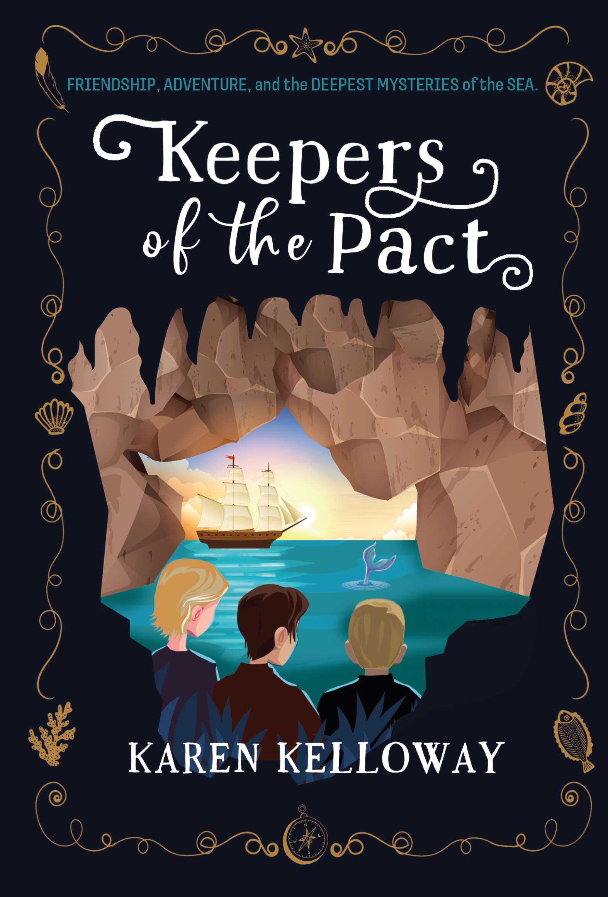

Classroom
Learning
Author Karen Kelloway

Slide 2



What’s Your Idea?

Slide 3

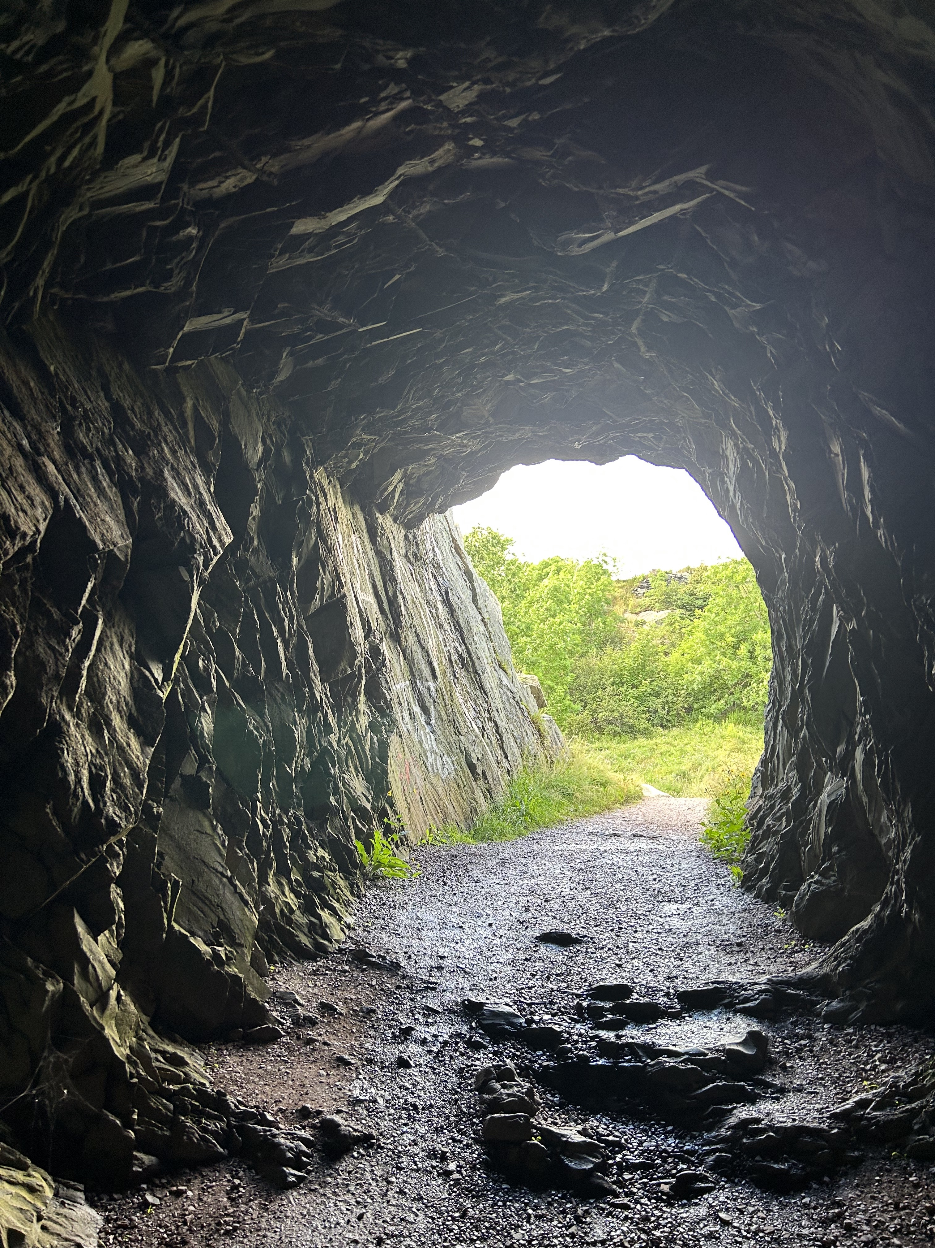
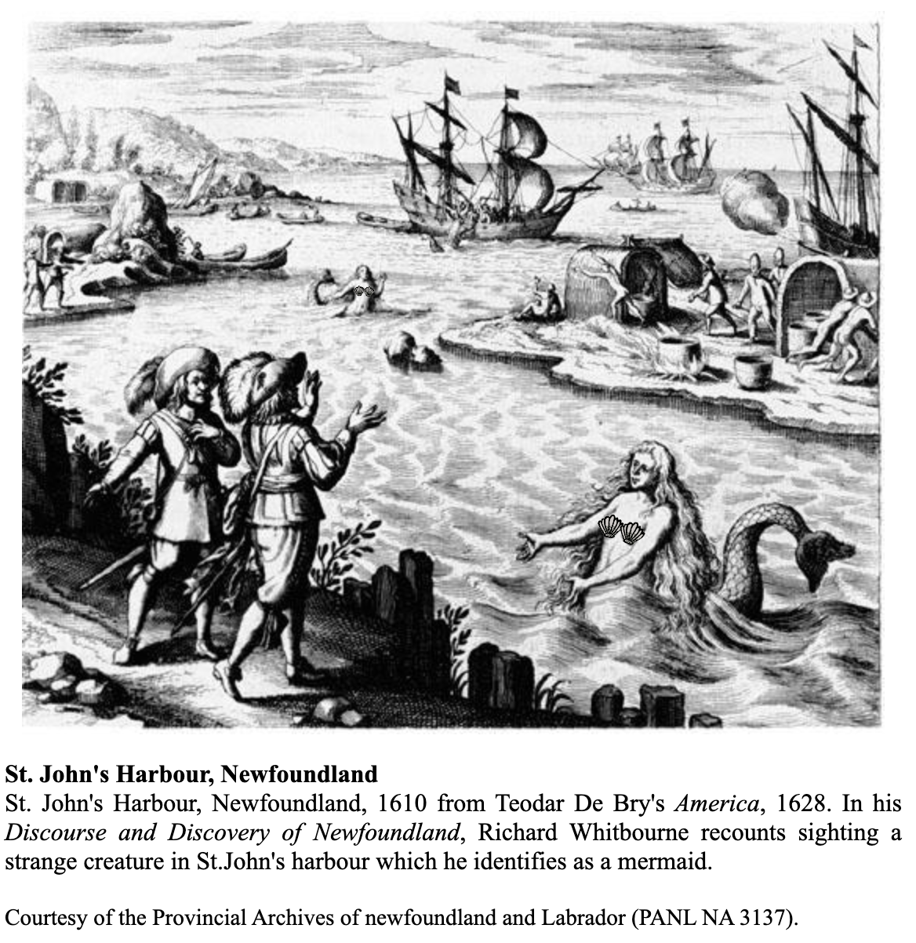
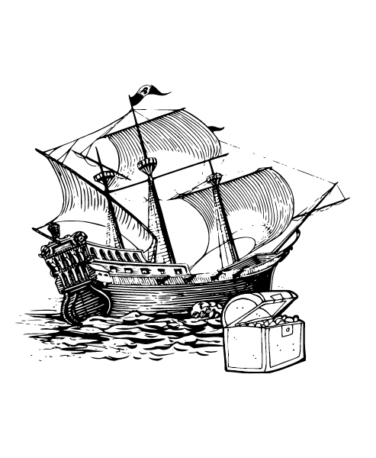
Three Anchors for my Story
Notes:
While Keepers of the Pact blends fact with fiction and adds in a supernatural twist, there are three anchors that influenced my story:
First, the Brigus tunnel, a 30-meter pathway blasted through solid rock in 1860 so that vessels could more easily unload their cargo.
Second, a reported mermaid sighting in the St. John’s harbour (1610).
Third, the fabled stories of Peter Easton’s pirating activities along the Newfoundland & Labrador coast (1612).

Slide 4
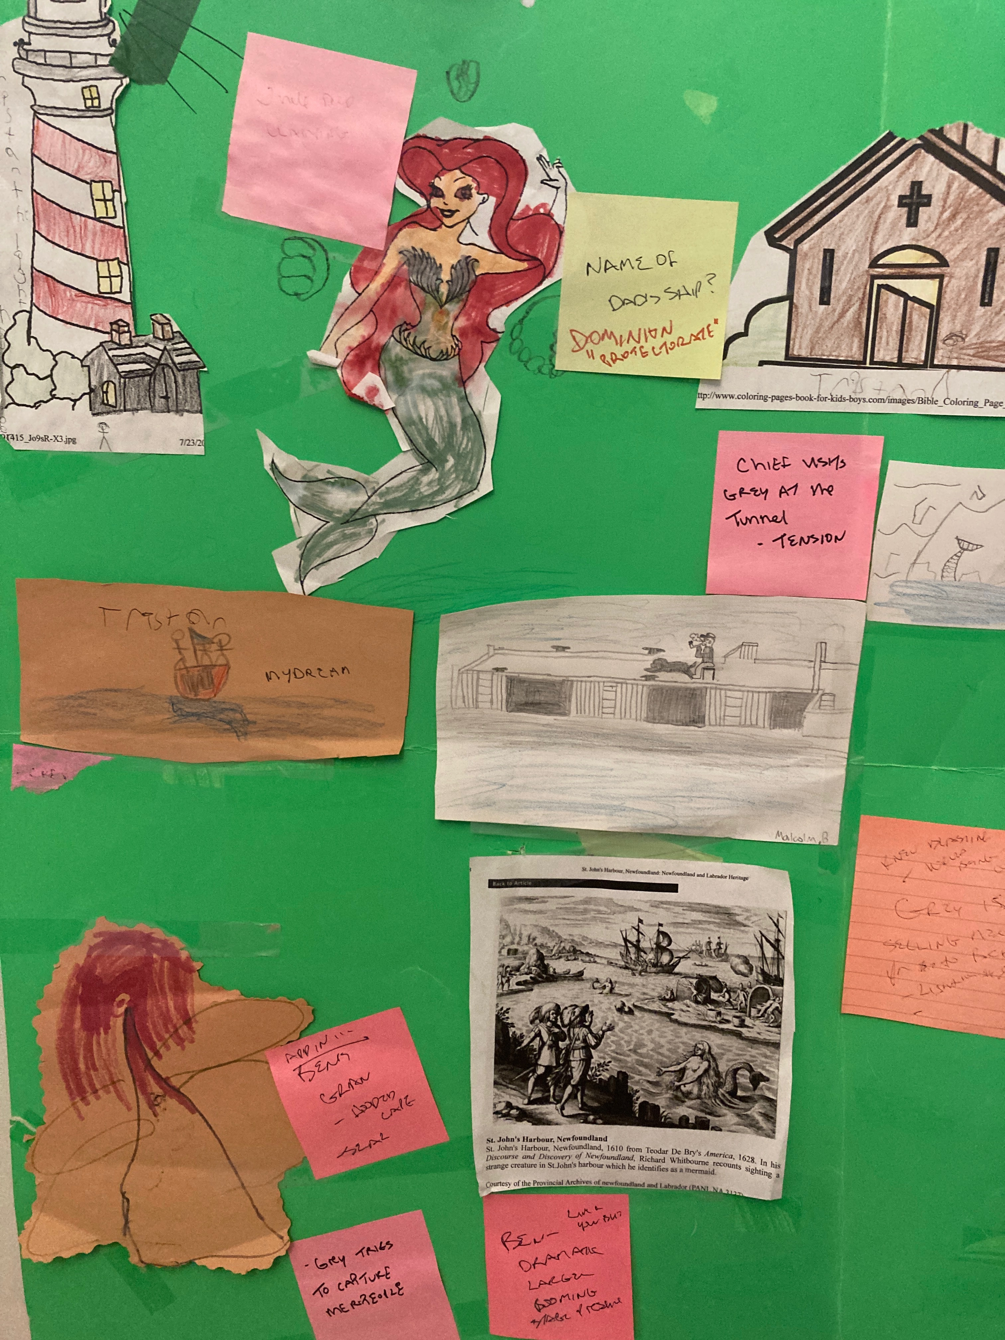
Start with a Story Board
Notes:
This is how I started my story! First, I came up with the idea then I started to map it out. My daughter was only young then so she colored the mermaid and lighthouse. My nephew, Malcolm, sketched the wharf with Old Man Jake and Brig as well as the the mermaid’s tale while my son sketched the mystery ship. I often will add sticky notes to ask myself questions and then take them down and put new ones up. It’s a place to put my ideas until I’ve integrated them into the story.

Slide 5
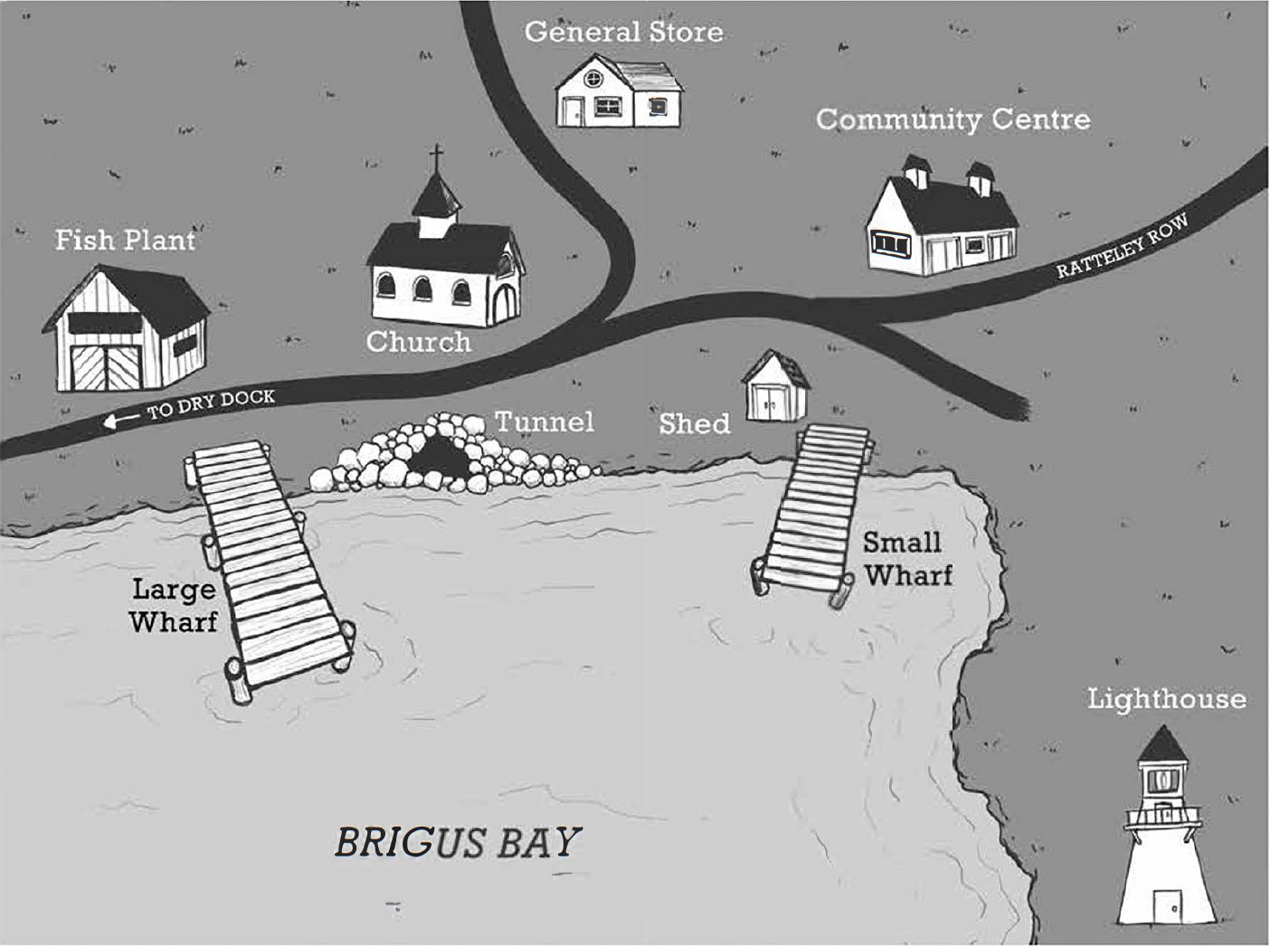
The Final Map
Notes:
And even though the book has some historical facts and the setting of the story is in a real place (the town of Brigus in Newfoundland & Labrador) I still made up some of the details. You can do that when you’re writing fiction. Here you’ll see a map the graphic designer created for the front of the book.

Slide 6


Just Write!
Notes:
Once you’ve mapped out some of your ideas, it’s time to jump in and start to write! I like to write in a journal when I’m creating fiction. Once I get to the editing process, that’s when I’ll switch to the computer. But do what works for you! Just get started.

Slide 7
3 Rs:
Research – Rework – Rewrite

Slide 8

Research!
Find facts that help make your story believable.
Examples…
  Ship Terms (interviewed author John Boileau)
Issues:
  How to get the kids onboard the mystery ship p. 87
  How to get a mer person off the ship p. 161
Notes:
When we’re writing fiction, the reader still has to believe what they’re reading. There will always be areas in the story that you can fact check. For me, I had a lot of ship and nautical terms. I don’t know how how to sail so I had to find someone who could help. There is only so much you can do with an internet search. I like to find real people to interview. I interviewed John Boileau, a Nova Scotian author who knows a lot about ships. I shared parts of my story where I was having issues and he helped me problem-solve.
On page 87, for example, you’ll read the part where the kids first climb on board the mystery ship. I first had them climbing a ladder. But John suggested that a cargo net would be a better way. I didn’t even know what a cargo net was! As you read that passage you’ll see how I worked that in.
On page 161, the friends are trying to save the mercreature. They need to get her off the ship. When you read this passage you’ll see that they wrap her in canvas. John shared with mer that there is always extra canvas on board a ship in case a sail needs to be replaced or mended. Again, another great idea that I wouldn't have known about if I didn’t interview a real person. AND it made the story more believable.

Slide 9

Rework!
Check your Character’s Believability
From:
Wearing Glasses
To:
Father’s Compass
From:
As Alistair scanned the landscape, something else entirely caught his attention. He turned the telescope to get a closer look. There, walking toward the lighthouse was Chief Joe. His broad shoulders hunched against the wind, but open to the elements. The eagle feather hanging from his long black braid seemed to magically dance around his cheek to the rhythm of each step. Alistair watched in awe. Then noticed the chief was looking directly up at him.
To:
As Alistair scanned the landscape, something else entirely caught his attention. He turned the telescope to get a closer look. There, walking toward the lighthouse in tan cargo pants and a purple T-shirt, was Chief Jo. Her brightly beaded headband and long single braid kept her dark hair in place despite the wind. Her long feathered earrings danced around her cheeks.
And even though she wore sunglasses, when she looked up, Alistair could tell she was looking straight at him.
p. 117
Notes:
Sometimes in the final edit we make what are called ‘global changes’ to help ensure the characters are believable and that the story flows.
In the first example, I originally had Alistair wearing glasses. The original manuscript had him taking them off in the boat, losing them in the cave, etc. The editor’s comment was that it felt ‘clunky’. As in, could he actually see the mystery ship from afar if he didn’t have his glasses on. And wouldn’t they get misted up on the ocean, etc. BUT if we took out the glasses we would miss the important scene on page 127. Initially Alistair's mom notices his glasses were on the seat of the skiff. We came up with the idea of the compass, which we introduce on page one and then from there had to continue that thread. That is an example of a global change.
Another example is the character Chief Joe. I had originally written Chief Joe as a male. I had Elder Gloria Johnson’s help with his character’s description which you’ll see in the first part. But later after reviewing this description again with a sensitivity editor, I learned that many male Mi’kmaq chiefs dress in fairly plain clothes now. The editor suggested we change the character to a female, because female Mi’kmaq Chiefs are much more colourful in how they dress. For example, they often wear beaded headbands, feathered or beaded earrings, and ribbon skirts. We decided to make this switch which also gave us another strong female character as one of the Pact Keepers. In this example you will see how we switched this character to a female Chief Jo. And tried to balance indigenous dress while keeping her believably modern day with sunglasses and a t-shirt.

Slide 10

Rewrite!
Make your Story Sing
From:
“He bent down to scoop handfuls of blueberries that overflowed from the low bushes on either side of the trail, popping them into his mouth.”
To:
“Alistair pulled a handful of berries off a bush and scooped them into his mouth. The subtle sweetness hit his tongue, a welcome change from the syrupy flavour of Ben’s candy corn.”
p. 53
From:
“Merpeople,” said Ben, his face agog. “It’s one of those merpeople.”
To:
“Merpeople,” said Ben, his face flushed. “It’s one of those merpeople.”
p. 98
Notes:
These changes are part of the final editing process. Notice the difference in the sentences. In the first example, we’ve added in more active verbs and added in a description of what the berries taste like.
In the second example, when I re-read that line, I pictured Ben as more ‘flushed’ then ‘agog’. Editing takes a lot of thought! You want to really think about the best word to create the picture in your reader’s mind.

Slide 11


Writing Exercise
10 – 15 minutes
Imagine you are playing in the ocean and you meet a merperson. Describe the scene:
What are you thinking?
How do you react?
What details do you notice about the merperson?
Do they talk? If so, how do they sound?
Notes:
I found it challenging to come up with original ways to describe a merperson because I hadn’t actually met one (yet). Here’s a writing exercise for you to come up with your own description.

Slide 12
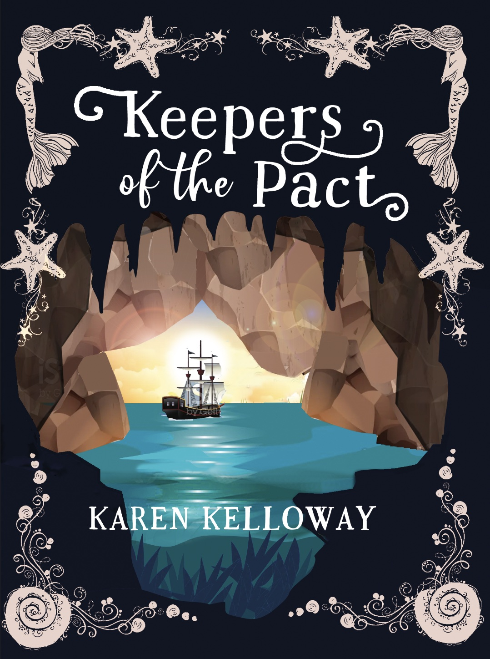
Final Touches
Notes:
Notice the first version the graphic designer created from the final. What changed?

Slide 13
Reflections & Questions

